Slide 1
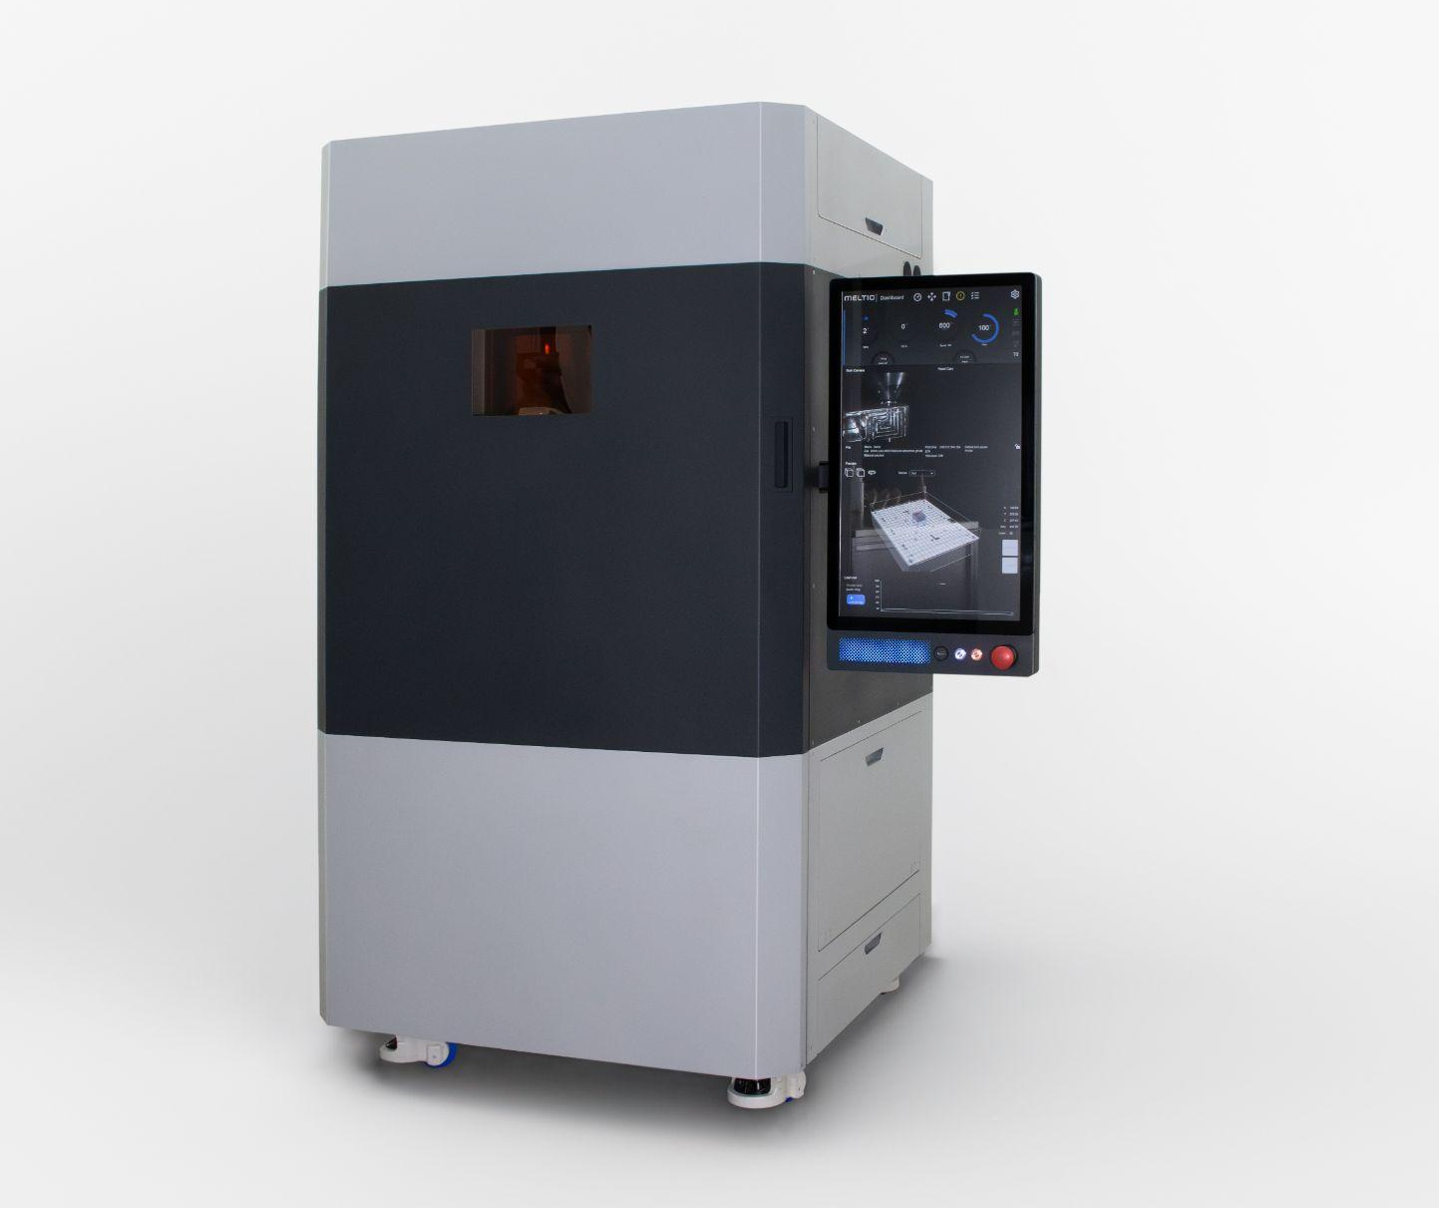
Meltio M600
Industrial Metal
3D Printer

Slide 2
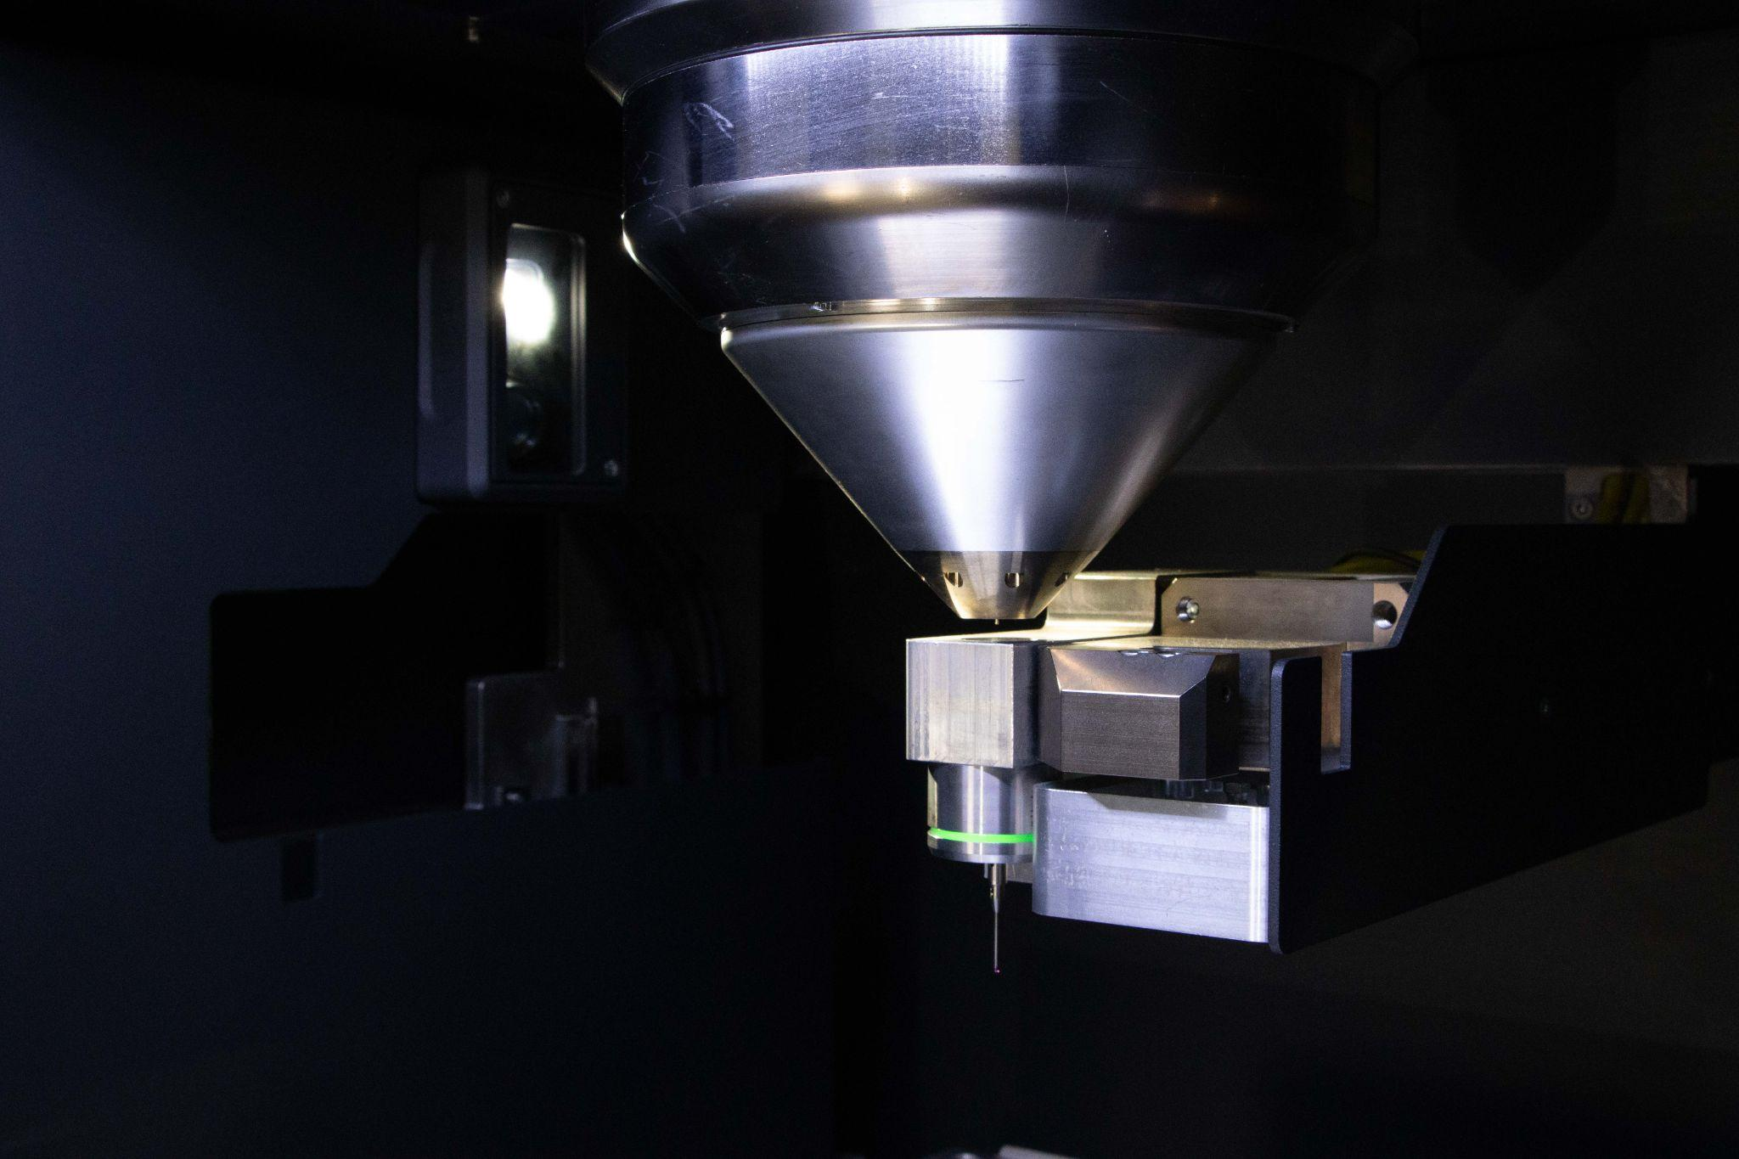
Today we will cover
To be completed

Slide 3
Industrial System
Production Ready
Bigger parts, Higher Deposition rate, Larger material range, inert print chamber, less maintenance and built-in workholding solutions make for a production ready system.
Ease of use
The Meltio M600 is easier to use than previous systems, with advanced sensor solutions, simplified UI, Dedicated Slicer, zero point clamping system etc. all designed to minimize operator interaction.
Reliability
The machine was redeveloped from scratch to address all weak-points of previous solutions, boasting an improved wire feeding system, fiber free deposition head, improved process control systems and many more making for an extremely reliable machine.
Reduced Maintenance
The newly developed deposition head removes the need for laser alignment, while the motion system has been improved and over-sized to ensure maximum life-times.
Integration
Integrating the system into existing manufacturing work-flows becomes easy thanks to the compact foot-print and flexible workholding architecture.

Slide 4
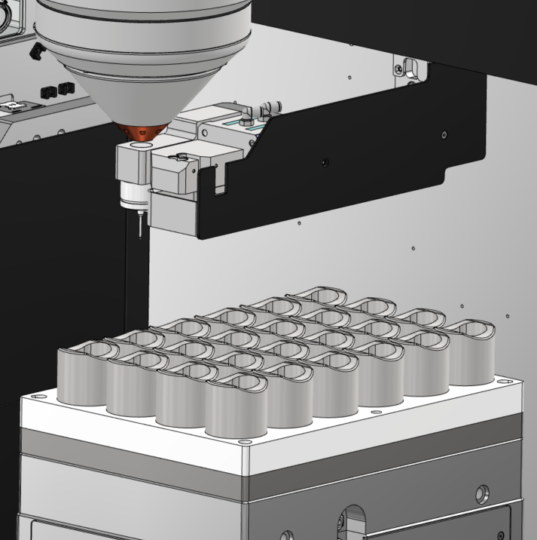
New Features
Inert Printing Volume
Fully inert printing volume of 300x400x600mm expands manufacturing possibilities to larger components while improving the quality for highly reactive materials like titanium. Further the system features humidity control within the work-volume.
Wire Cutting
The wire cutter extends the nozzle's lifespan by preventing unnecessary retractions on material changes and removes the possibility of hot material contaminating and damaging the nozzle.
Zero Point Campling
Quickly exchange Build-plates or fixtures for high machine uptime and without the need for re-indexing in your machining or cutting system.
NEW Wire Feed system
The Meltio M600 can be equipped with up to 4 units of our new and improved closed loop wire feeding system with double traction.
Probe System
Equipped with a high precision 3 Axis probe, the M600 can locate the origin of components and fixtures without manual intervention.
Print Recovery
The M600 saves the precise position of the motion system, enabling work recovery in case of incidents and Power loss.

Slide 5
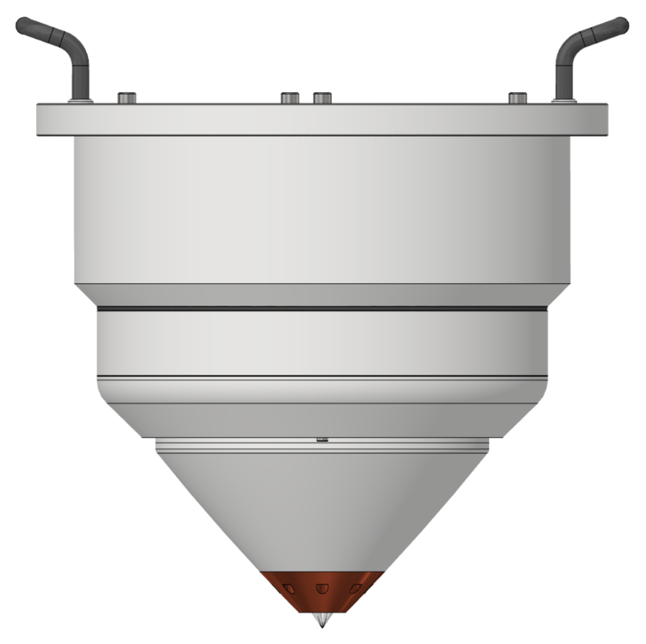
Blue Laser Head
Blue Light
450nm Light improves energy absorption and printing efficiency across the metal material spectrum and opens new material possibilities.
No calibration
The new head doesn't require calibration between material changes and arrives aligned from the factory for maximum printing repeatability and minimal maintenance.
Hotwire Compatible
The deposition head is developed for use with an optional hotwire supply to increase the deposition rate and allow for more materials to be processed.
High Efficiency
Thanks to the high efficiency Blue laser diodes and the increased absorption, the energy consumption per component is reduced significantly, resulting in a greener and more cost efficient process.

Slide 6
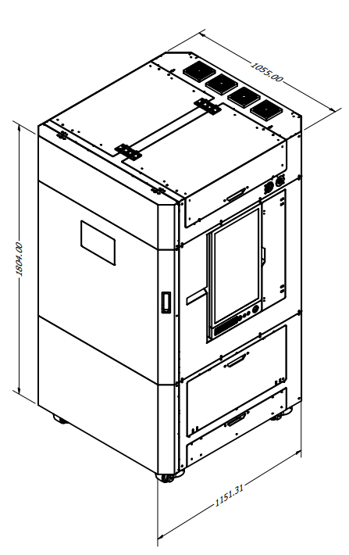
System Specification
Dimensions | 1050 x 1150 x 1950 mm | Power Input | 400V Three Phase
Build Envelope | 300 x 400 x 600 mm | Power Consumption | 4-6 kW Peak Depending on selected options
System Weight | 900 kg | Process Control | Closed Loop, Laser and wire Modulation
Movement System | Servo Motor Linear axis with Absolute encoder on all axis. | Touch Probe | Automated XYZ Touch Probe integrated
 |  | Enclosure | Laser safe, Fully Inert
Filtration system | 3 Stage Particulate and Chemical Filtration included. | Interface | USB, Ethernet, WiFi
Environment Control | Control O2 and Humidity level. | Cooling | Active Water cooled Chiller Included
Laser Type | 9x Direct Diode Lasers | Wire Feedstock Diameter | 0.8-1.2mm
Laser Wavelength | 450 nm | Wire Feedstock Spool | BS300 or External Wire Drum
Total Laser Power | 1000 W

Slide 7
System Specification
Option Extras: M600 master doc
Upgrades and Accessories
Hot Wire | Programmable power supply that preheats the material to increase deposition rate
Multi-Wire | This option allows for sequential 3D Printing of up to 4 materials with very fast automatic wire switches.
External Wire Drum Connection | Connect external wire drums to the M600, allowing the use of 100kg and 200kg material packs.
Zero Point Clamping System | Accurately and quickly couple fixture plates to the print bed of the M600 for production.

Slide 8
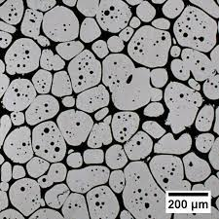
Material and Feeding System
Aluminum and Copper Ready
The Meltio M600 is compatible with steel, carbon steel, nickel, titanium, aluminum and copper based alloys.
Dual and Quadruple Wire
Options for printing with up to four different materials in the same print sequentially with the reliability of a single wire process.
Wire Drum Ready
The wire drum connector allows for a reliable and industrial feeding system for material spools of +100kg.
Hot Wire
Increase deposition rates up to …
Option Extras: M600 master doc

Slide 9
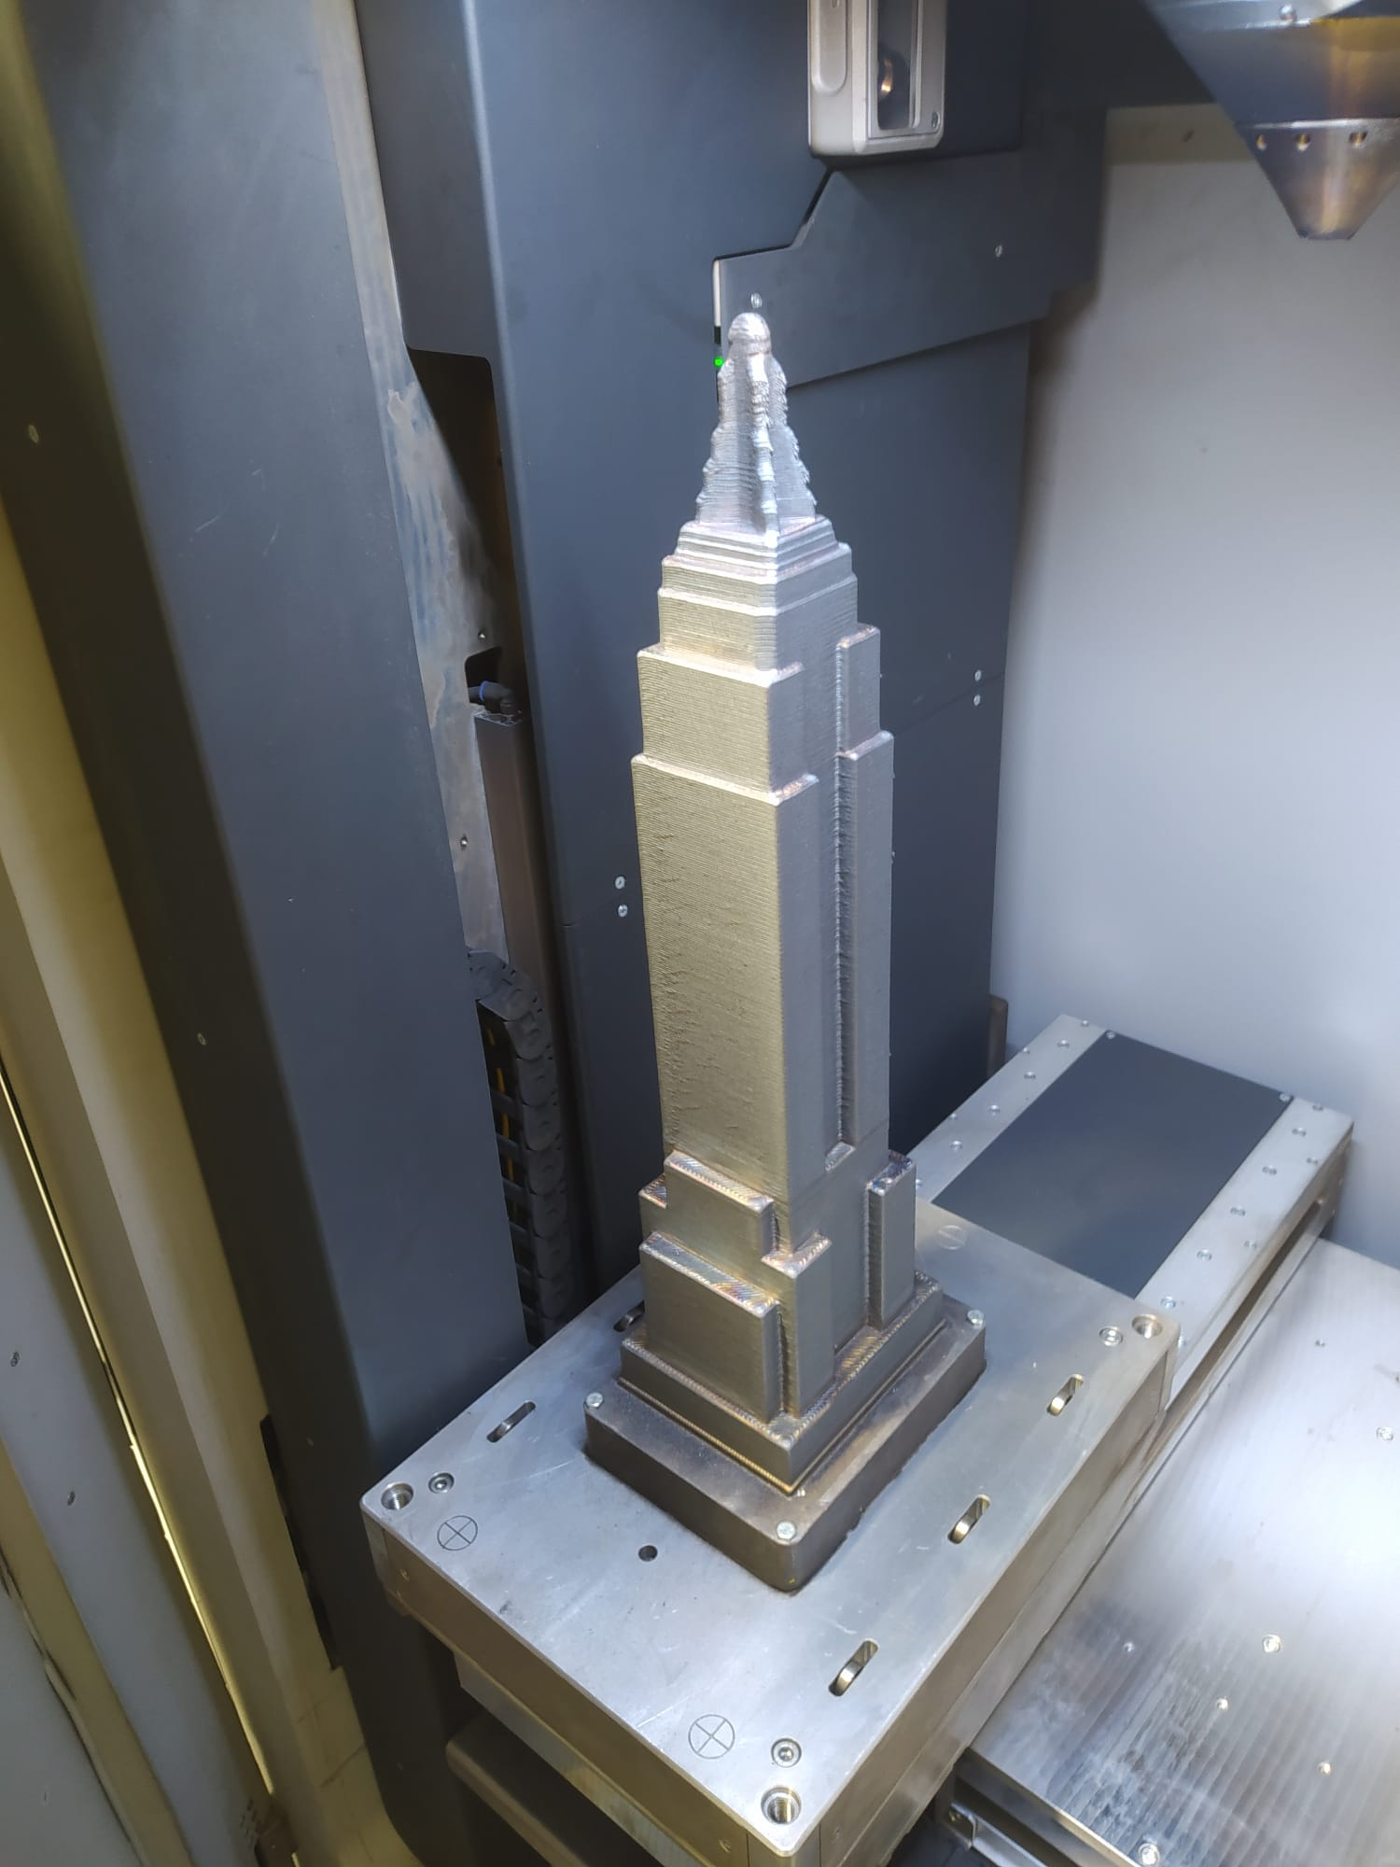
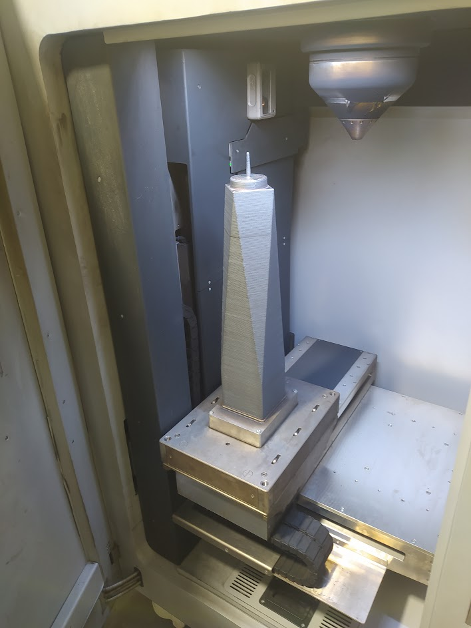
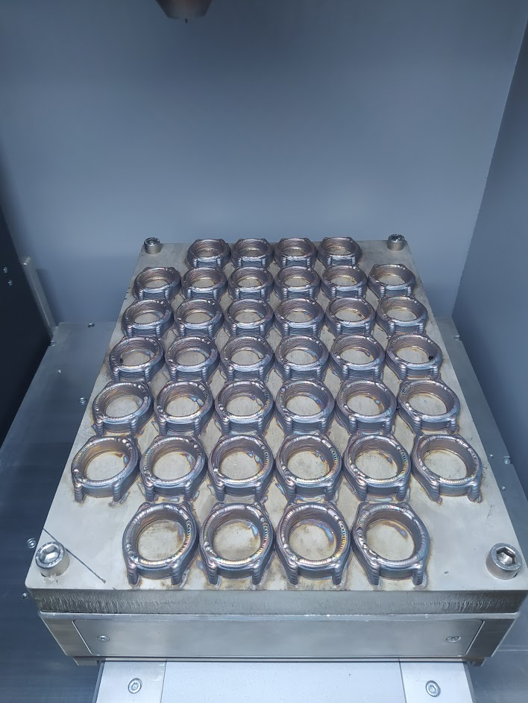
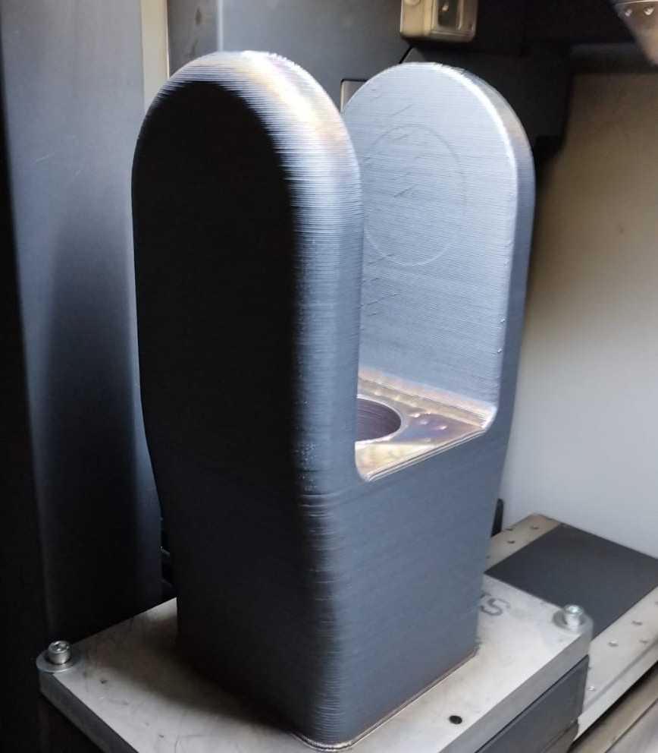
Status
We have manufactured and commissioned 2 M600 Machines which have been undergoing testing since April. Manufacturing of the beta machine batch begins shortly.
Example parts from testing program:
Shell Mill Body
Bronze
Weight: 5,95 kg
One World Trade Center
SS316L
Weight: 55 kg
Universal Joint
SS316L
Weight: 97 kg
38 Watch Bezels
SS316L
Weight: 3 kg

Slide 10
Examples printed on M600
Shell Mill Body
Bronze
Weight: 5,95 kg
One World Trade Center
SS316L
Weight: 55 kg
Universal Joint
SS316L
Weight: 97 kg
38 Watch Bezels
SS316L
Weight: 3 kg

Slide 11
Examples printed on M600

Slide 12
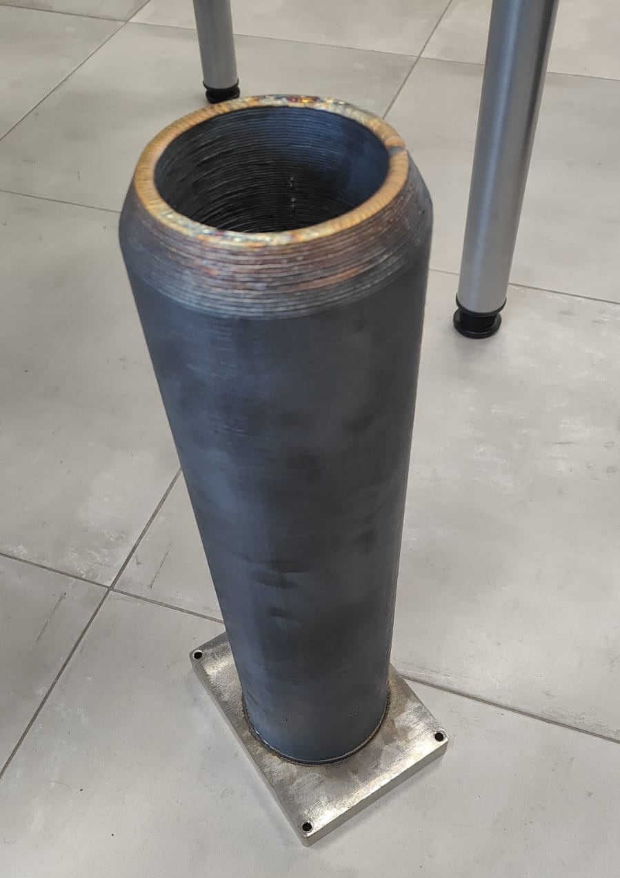
Examples printed on M600

